Slide 1

Predicting NBA Game Point Spread
Deric Liang, Dylan Brazier, Zakaria Ali

Slide 2

Motivation
Introduction:
Objective: To predict the point spread for NBA games.
Importance: Enhances betting strategies and provides insights into game outcomes.
Previous Work: Existing sports betting models, with varying success. Generally, sports betting loses money.
Overall Plan:
Data Collection: Sourced from Kaggle, includes game scores, betting odds, and other metrics.
Data Processing: Compiled team performance metrics and normalized by season.
Model Development: Trained machine learning models to predict spread -> bet strategy
Summary of Results:
Developed models to use with Kelly Criterion, resulting in strategy to net a positive return from spread betting.

Slide 3




Data Collection
SOURCE: KAGGLE DATASET (2012-13 TO 2018-19 SEASONS).
DATASET DETAILS: SCORES DATA: INCLUDES GAME METRICS LIKE FG%, FT%, FG3% FOR REGULAR SEASON GAMES.
TEAM PERFORMANCE METRICS: POINTS, REBOUNDS, ASSISTS, RESULTS, ETC.
VEGAS DATA: BOOKMAKER’S SPREAD BETS AND ODDS FOR GAMES.

Slide 4
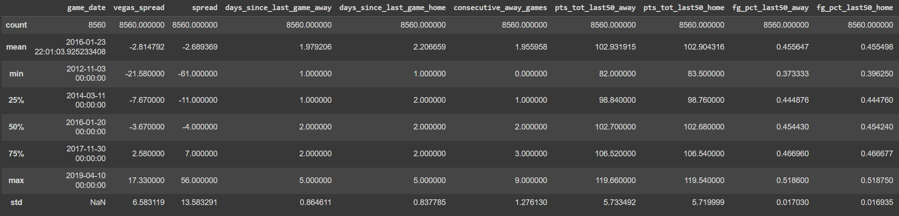
Sample of Relevant Summary Statistics

Slide 5



Data Processing
OVERVIEW: DATA PRE-PROCESSING AND EDA PERFORMED IN DATA_PROCESSING.IPYNB
STEPS INVOLVED: COMBINED SCORES AND VEGAS DATA.
CALCULATED TEAM PERFORMANCES OVER THE PREVIOUS 10, 20, AND 50 GAMES.
CONSOLIDATED DATA TO GAME-LEVEL AND NORMALIZED TEAM PERFORMANCE METRICS WITHIN SEASON.

Slide 6
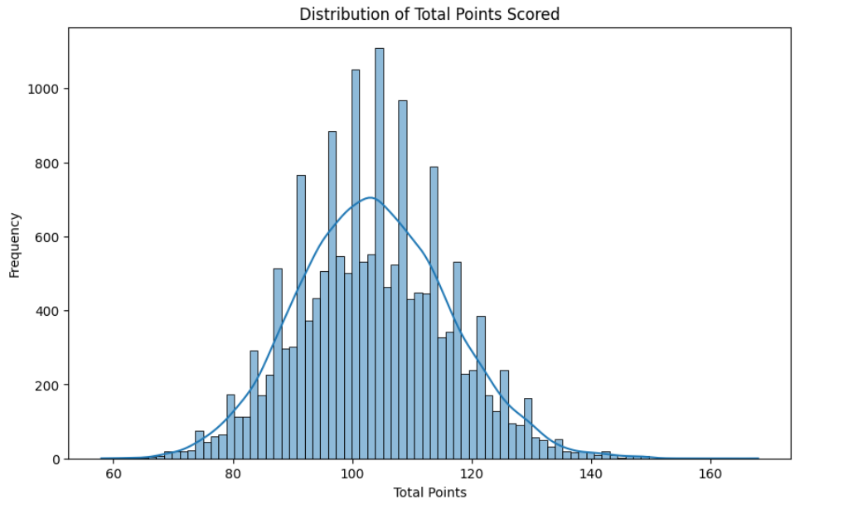
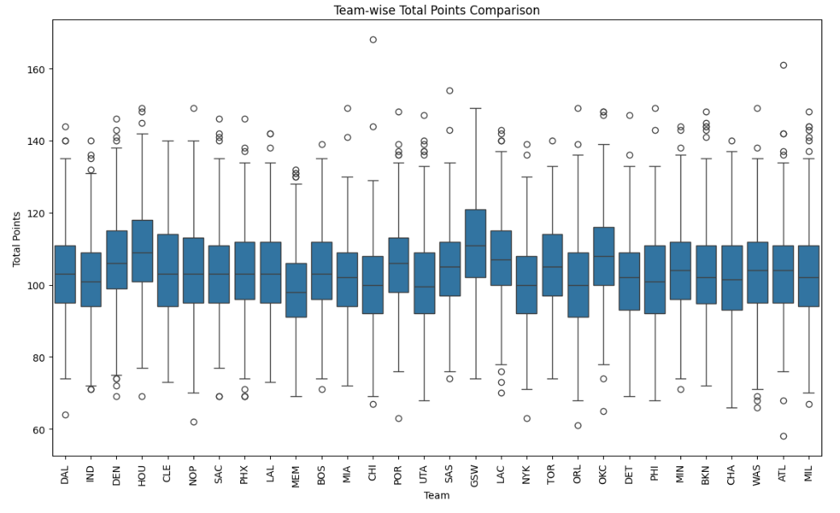
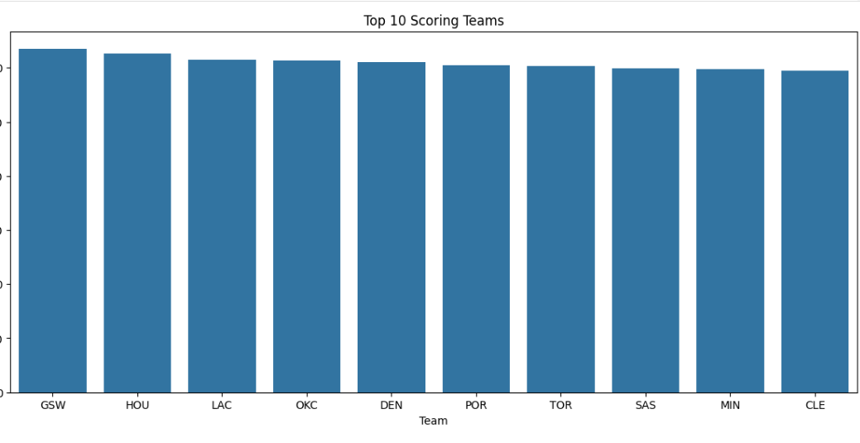
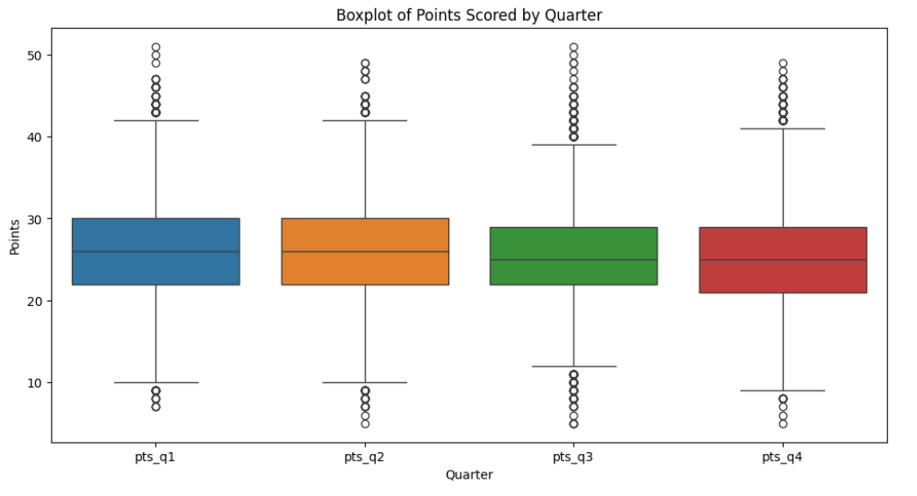
Visualization - Data

Slide 7
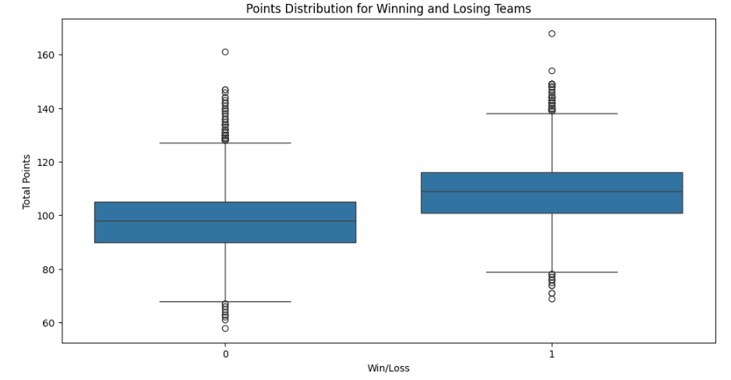

Slide 8
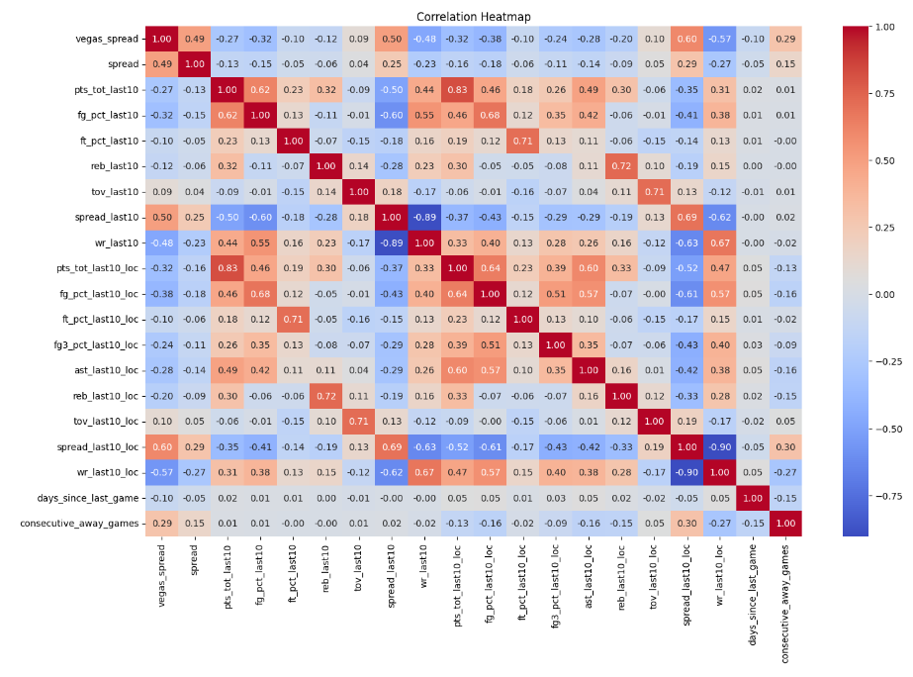

Slide 9
Modeling
Approach:
Spread, classification on covering Vegas spread, returns
Baselines, improved models using normalized data.
Machine Learning Algorithms:
Implemented using TensorFlow and scikit-learn.
Feature Engineering:
Calculated team performance over various game spans (10, 20, 50 games).
Evaluation Metrics:
Mean Squared Error (MSE), Accuracy, Kelly Criterion
Performance Comparison:
Baseline vs. improved models.
Visualization:
Graphs and tables from model testing and experiments

Slide 10




Justification for Non-Linear ML Approach
Complex Relationships:
Feature Interactions:
Model Performance:
Real-World Applicability:
NBA game outcomes involve a complex interplay of features
Games can often be tossups; upsets are frequent
Linear models may not capture these intricate relationships effectively
Non-linear models capture interactions between features
Combined effects of team statistics can be non-linear
Our nonlinear models for predicting spread as initial exploration (e.g., Random Forests, Neural Networks) slightly outperform linear models (baseline validation loss: 0.92 vs. improved validation loss: 0.87)
Better capture of non-linear dependencies results in improved predictions
Real-world relationships between human behavior variables are rarely linear
Non-linear approaches lead to better generalization and reliable predictions

Slide 11
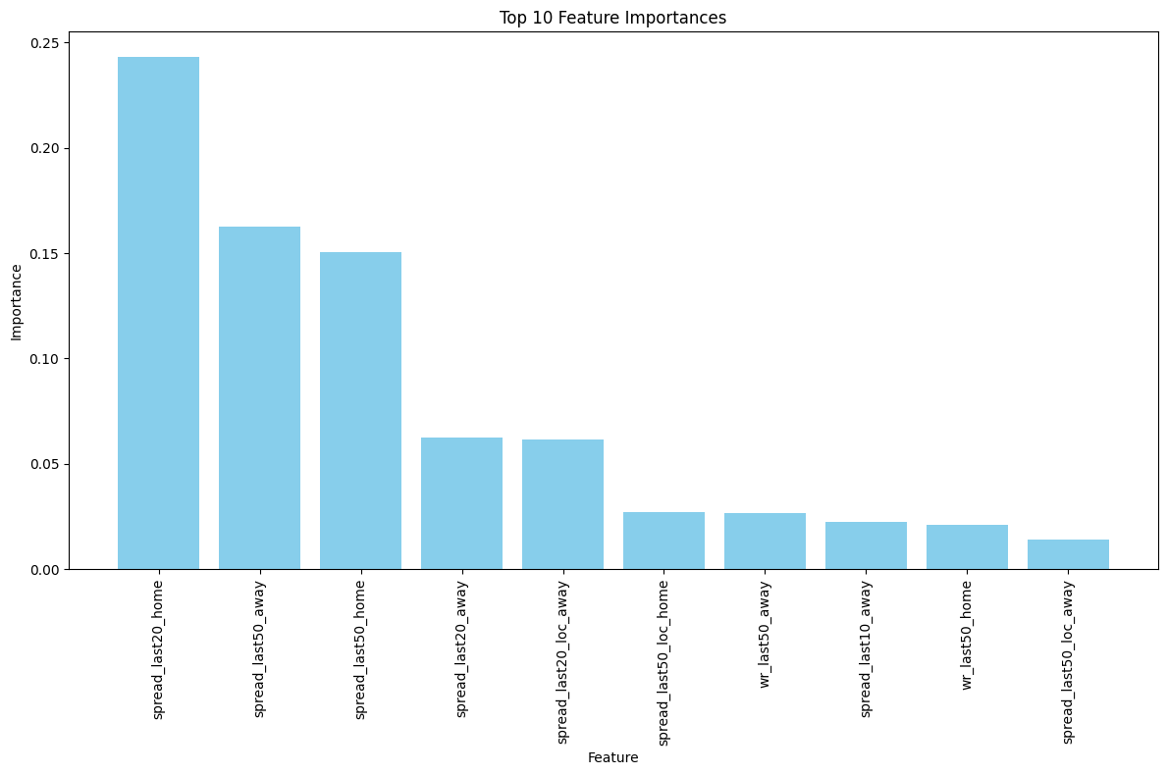
ML Modeling - Neural Network
Model Architecture
Input layer: Features reflecting team performance and game related statistics
Hidden layer:
Layer 1: 10-300 neurons, ‘relu’ or ‘tanh’ activations
Dropout 1: Rate between 0 and 0.5
Layer 2: Similar to layer 1
Dropout 2: Rate between 0 and 0.5
Output layer: Single neuron to predict probability that Vegas spread is covered
Final model: tanh activation, dropout rate 0.5, learning rate 0.01, 230 neurons in layer 1, 20 neurons in layer 2
Hyperparameter tuning
Tool Used: Hyperopt Library
Tuned parameters: Neuron counts, activation functions, dropout rates, learning rate
Goal: Achieve lowest possible validation loss to maximize accuracy
Training Process
Consistency from setting seed, trained 15 epochs with batches of 32 samples
Validation phase to prevent overfitting and monitor generalization

Slide 12



Kelly Criterion
Idea:
Formula: f* = p - (1-p) / b
Result:
Generates betting strategy (i.e., bet sizing) in gambling context, given a bankroll.
Formula based on probability of a win and odds to return percentage of bankroll to wager.
f*: percentage of bankroll to wager
p: probability of winning the bet
Utilize output of NN to generate win probability (i.e., probability of covering the spread)
b: proportion of bet gained with a win
Allows us to account for confidence in bet, rather than binary win/lose classification
Low confidence in result = smaller bet
Generates strategy to win money over time
Our analysis assumes $100 bankroll available for each game

Slide 13




Experiments
HYPERPARAMETER TUNING: OPTIMIZATION OF MODEL PARAMETERS TO ENHANCE PREDICTIVE EFFICIENCY AND ACCURACY
CONDUCTED EXPERIMENTS WITH DIFFERENT HYPERPARAMETERS USING HYPEROPT TO OPTIMIZE MODEL PERFORMANCE
HYPEROPT EVALUATES MIX OF PARAMETERS - REPEATED EXPERIMENTS TO SETTLE ON BEST HYPERPARAMETERS
EVALUATED IMPACT OF HYPERPARAMETER CHOICES ON MODEL PERFORMANCE USING ACCURACY AND KELLY CRITERION

Slide 14
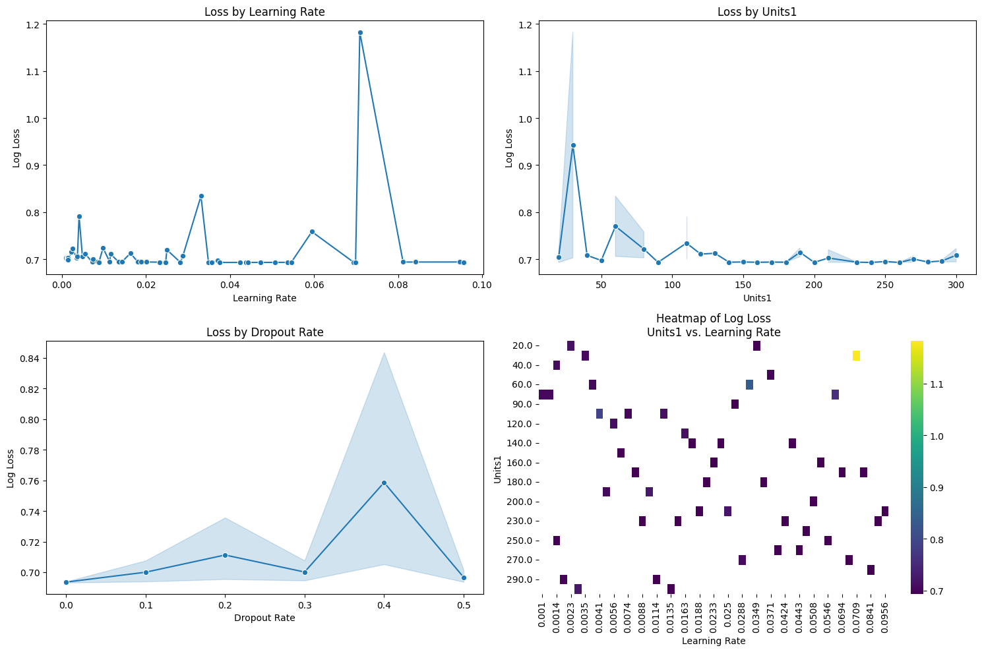
Visualization - Experiments

Slide 15
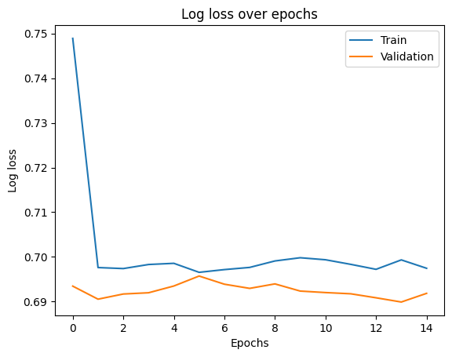
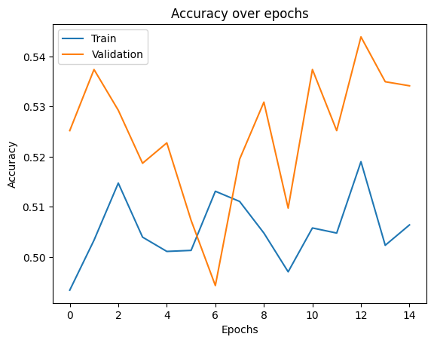
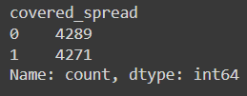
Visualization - Final

Slide 16
Results - Kelly Criterion
Dataset | Total return | Number of games | Percent return | Average return per game
Baseline - validation | $0 | 1,230 | 0% | $0
Training | $5,691.82 | 6,104 | 43.9% | $0.93
Validation | $2,611.47 | 1,230 | 56.8% | $2.12
Test | $2,041.75 | 1,226 | 43.6% | $1.67

Slide 17


Conclusion and Future Work
Summary:
Developed a model to predict NBA game point spreads, whether the Vegas spread is covered, and betting strategy
Benchmarked predictions against actual game spreads, Vegas spreads and betting odds.
Future Work: Sourcing data on player stats; advanced team stats - PACE, eFG%, Offensive/Defensive ratings; newer games

Slide 18

Q&A

